Slide 1


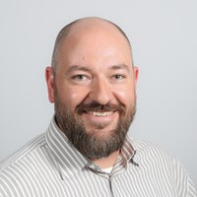




Speaker
Richard Toland
Advanced PowerShell for remote SharePoint administration & inspection
Richard Toland
rrtoland
September 16th & 17th
^{Online Event}
Powered By
International Conference

